Slide 1
HR ANALYTICS (Employee Retention)

Slide 2

Group Members
Saishwar
Pratyusha
Raj
Renuka
Sandhya
Manideepika
Lokesh
TEAM

Slide 3





Introduction & Problem Statement
Business Objective
KPIS
AGENDA:-
Dashboard
Conclusion

Slide 4
Introduction: HR analytics involves the collection and analysis of HR-related data, including employee data, performance metrics, and other relevant data points. By using advanced analytical tools and techniques, HR analytics provides valuable insights into HR processes and trends, enabling organizations to make more informed decisions about their employees and improve overall performance.
Problem Statement:
Average attrition rate for all Departments
Average hourly rate of Male Research Scientist
Attrition rate Vs Monthly Income stats
Average working years for each Department
Job role Vs Work life balance
Attrition rate Vs Years Since last promotion

Slide 5

The aim of this project is to analyze employee retention and attrition rates with the organization and provide insights to the HR team for developing effective retention strategies. Through data analysis and visualizations, we will identify factors that contribute to : Employee turnover and attrition. Evaluate the effectiveness of existing retention strategies. To verify the satisfaction level of employee in the organization. Provide recommendations to improve employee retention.
Business Objective:

Slide 6
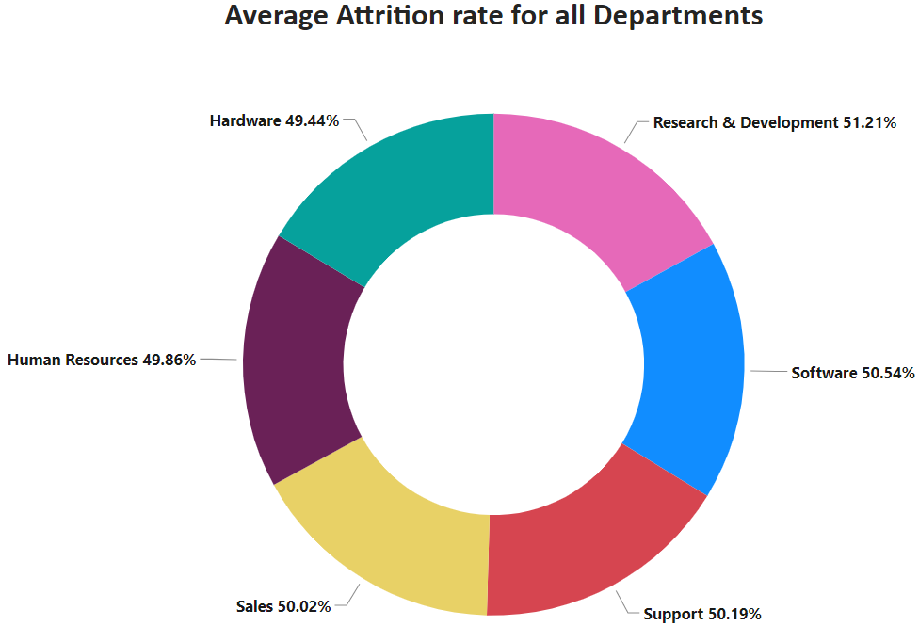
KPI 1
This KPI is to find out the
relationship between each
department and its attrition rate and here attrition rate is highest for Research & Development Department whereas lowest is for Hardware Department

Slide 7
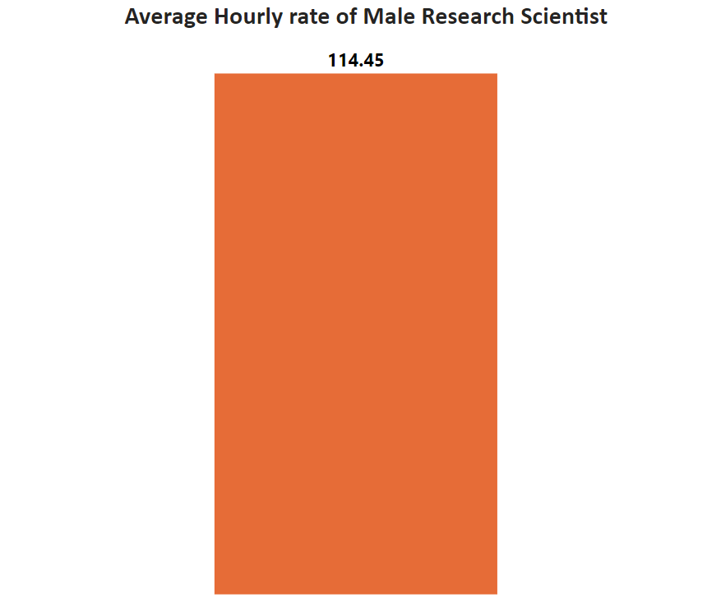
KPI 2
KPI 2 :
This KPI is to find out the average hourly rate of male research scientists which is 114.45.

Slide 8
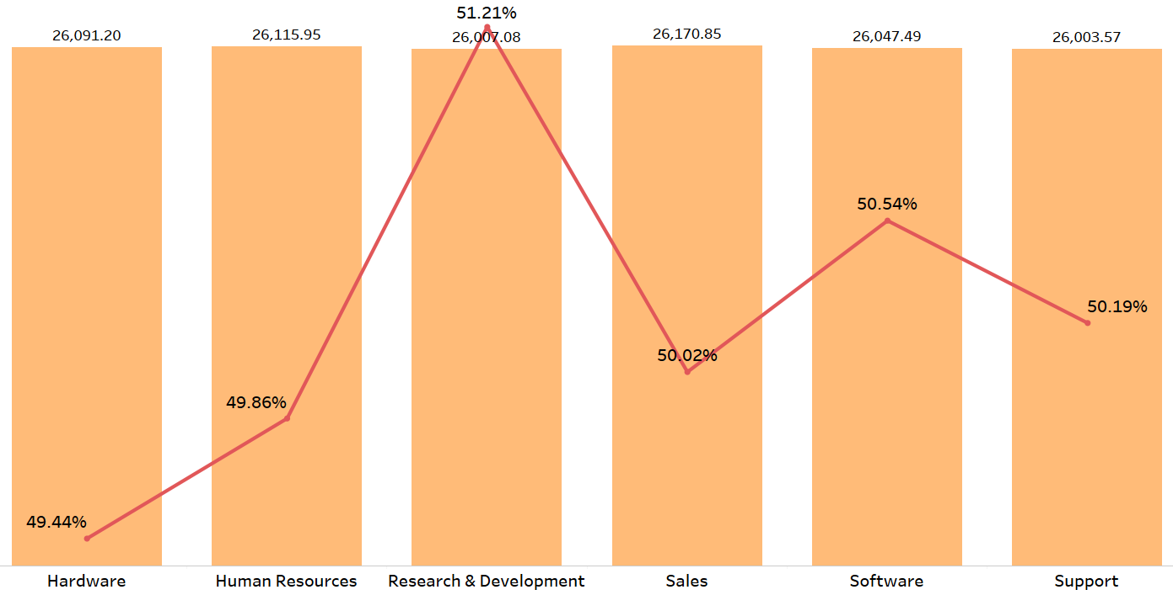
Attrition Rate Vs Monthly Income Stats
KPI 3
This KPI is to find out the relation between monthly income and Attrition rate.

Slide 9
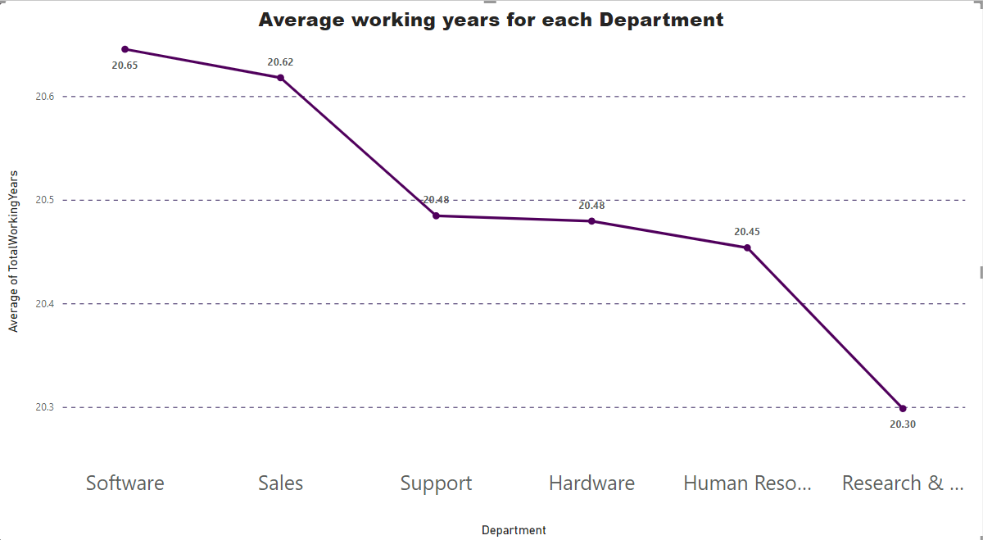
KPI 4

Slide 10
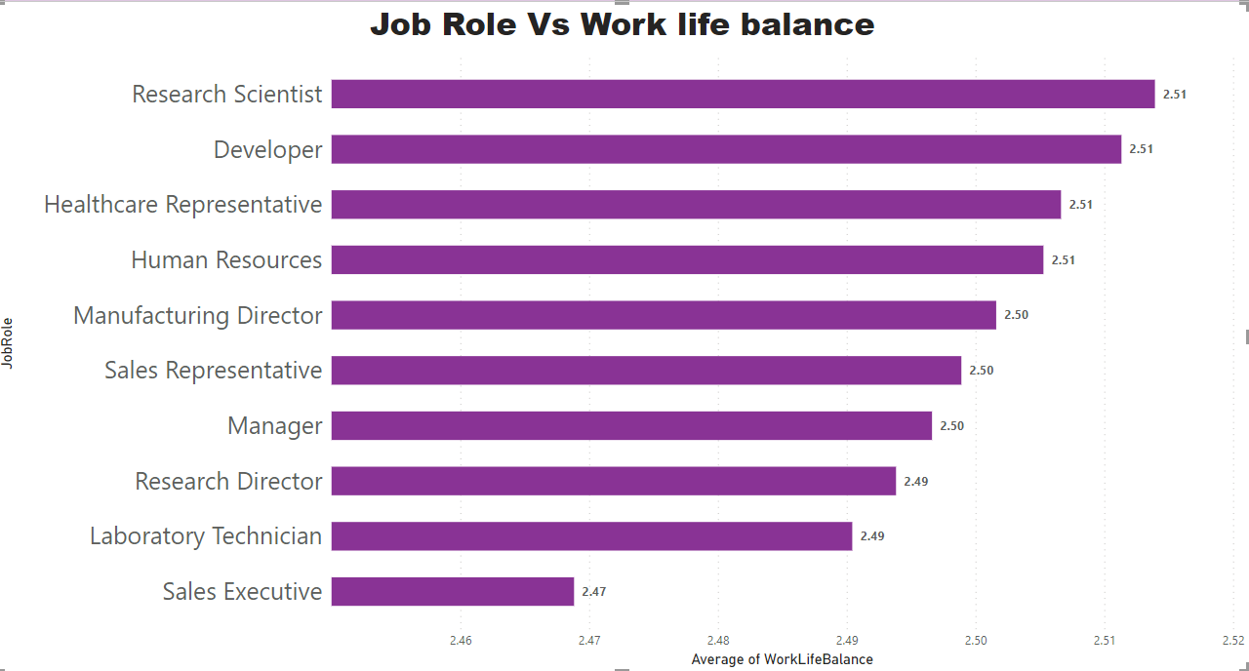
KPI 5
This Kpi shows difference between Job Role Vs Work life balance

Slide 11
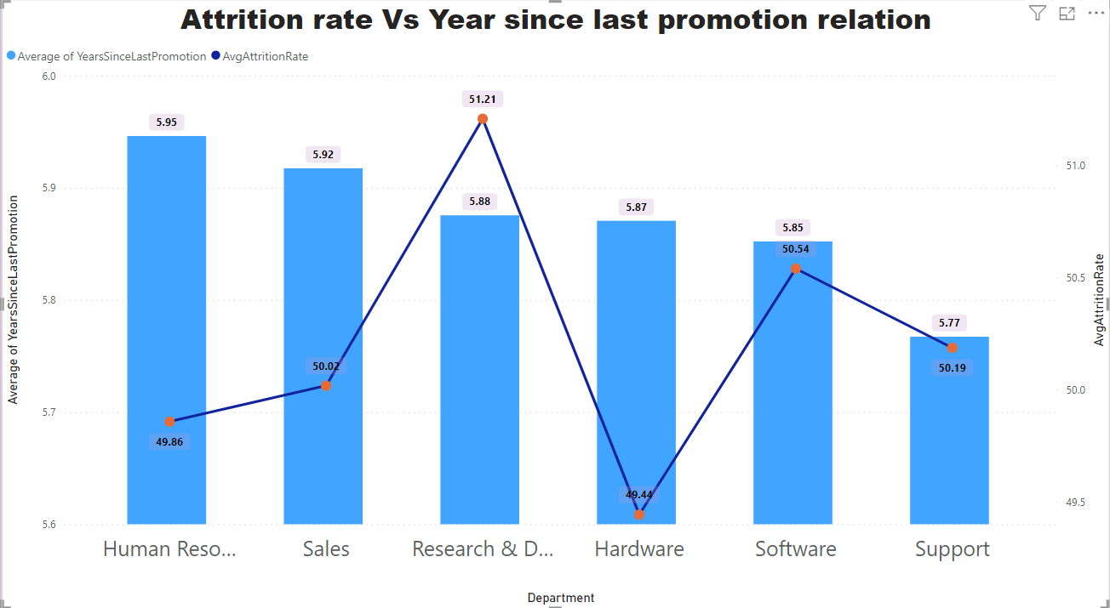
KPI 6
This KPI is to find out the relation between Attrition rate and last promotion relation

Slide 12
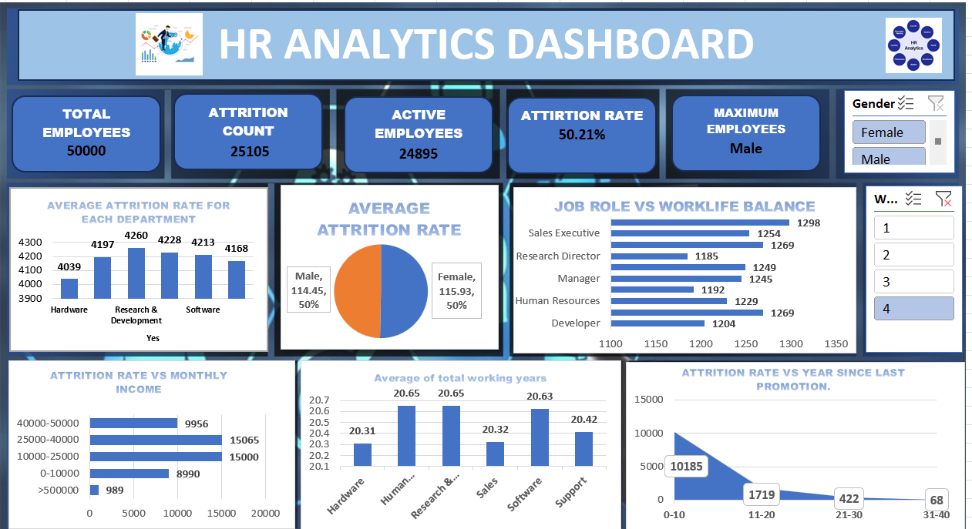

Slide 13
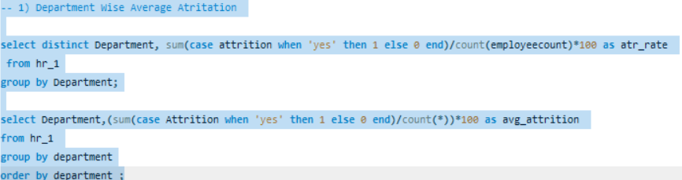
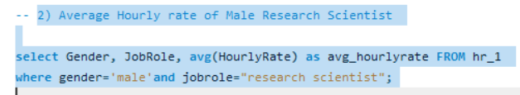

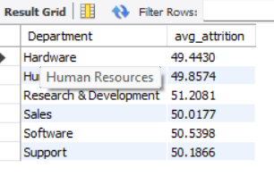
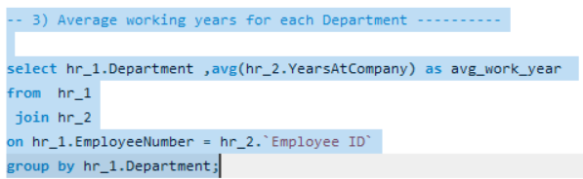
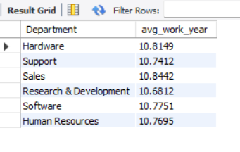
SQL KPI’S
1
2
3

Slide 14
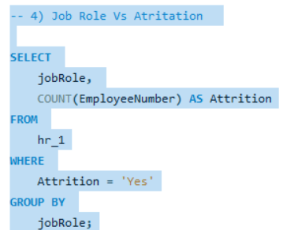
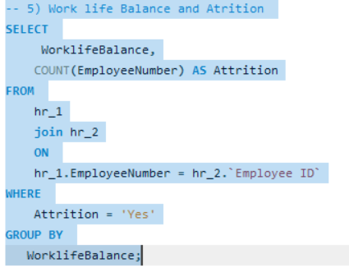
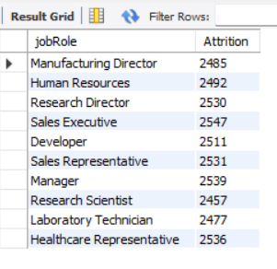
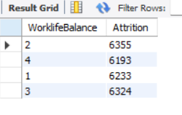
4
5

Slide 15
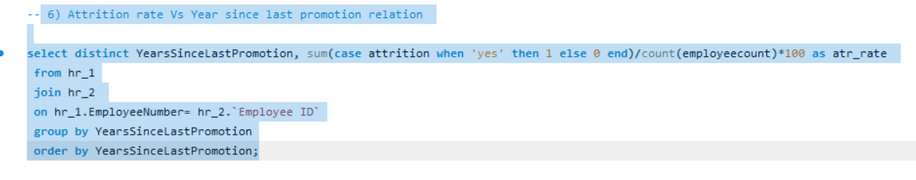
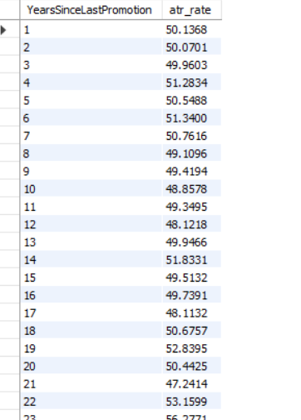
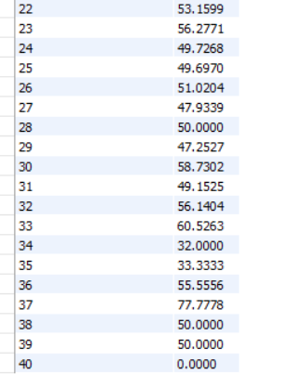
6

Slide 16
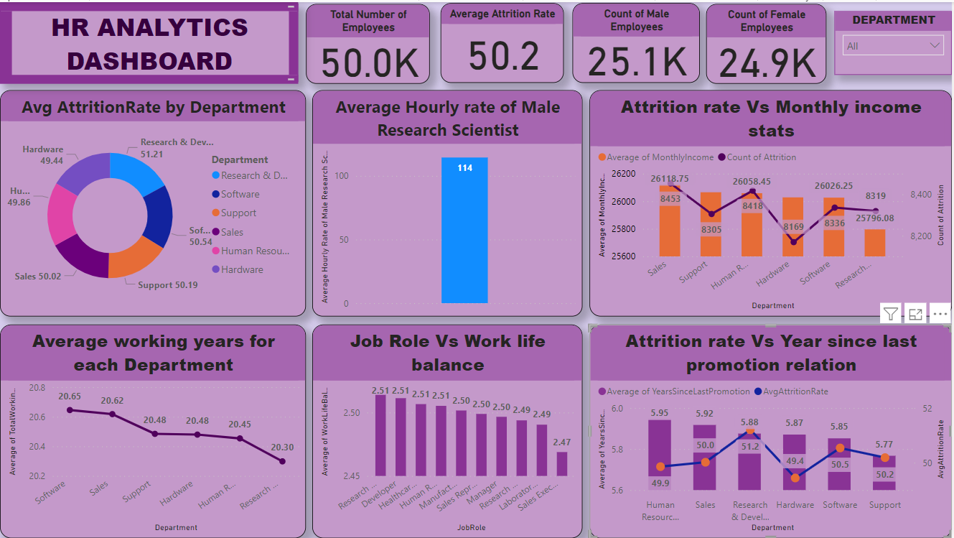

Slide 17
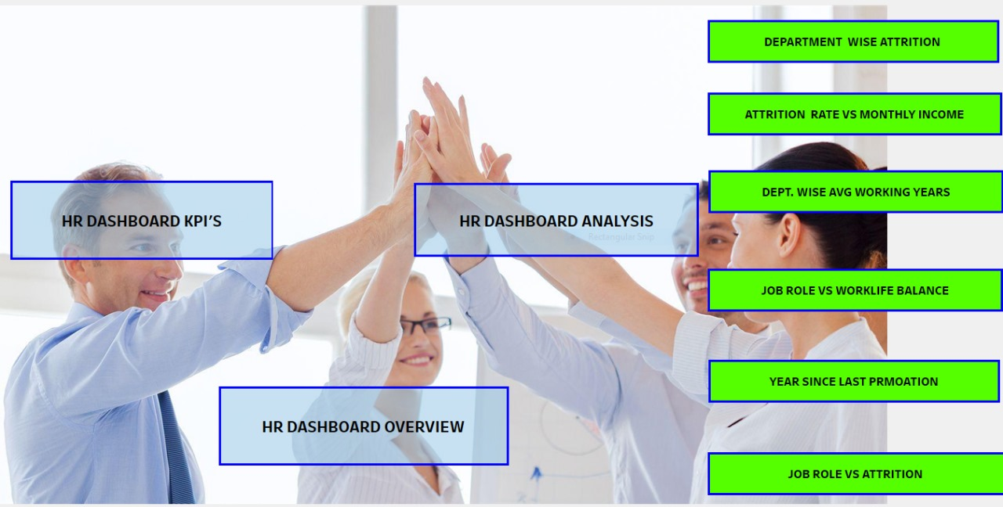

Slide 18
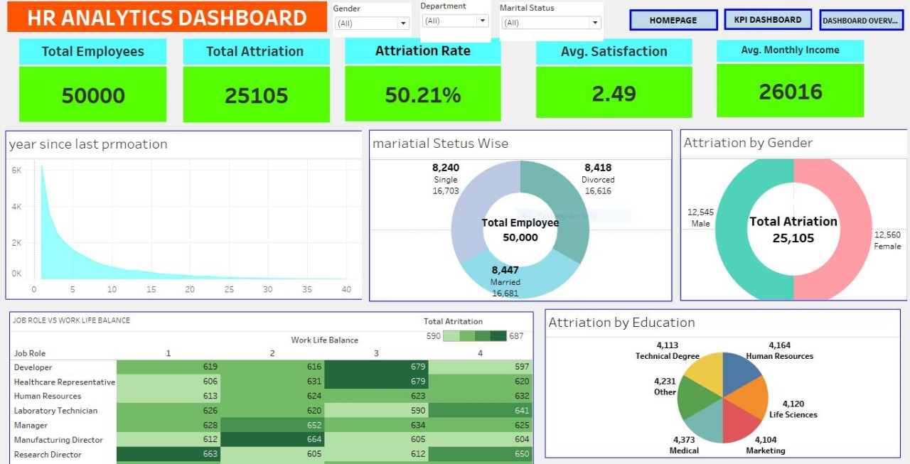

Slide 19
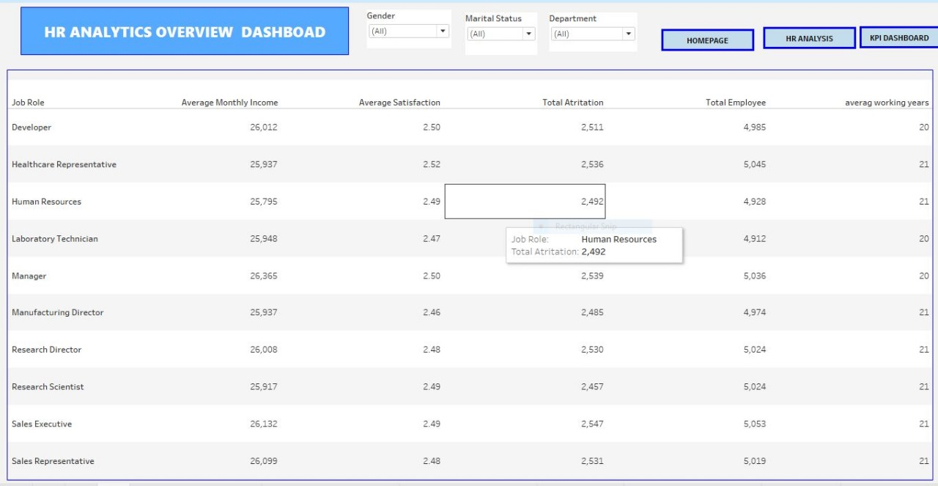

Slide 20
Detailed Insights from the Dashboard:
Total Employees and Attrition:
Total Employees: 50,000
Total Attrition: 25,105, which leads to an Attrition Rate of 50.21%.
This high attrition rate indicates significant employee turnover, which could be a concern for the company.
Average Satisfaction and Monthly Income:
Average Satisfaction Score: 2.49, suggesting that employees are generally not very satisfied.
Average Monthly Income: ₹26,016, which may be on the lower side for certain job roles, possibly contributing to high attrition.
Attrition by Gender:
Male Attrition: 12,545
Female Attrition: 12,560
Attrition is almost equal between males and females, indicating that gender might not be a significant factor in attrition.

Slide 21
4. Attrition by Marital Status:
Single: 8,240 (16,703 total employees)
Married: 8,447 (16,681 total employees)
Divorced: 8,418 (16,616 total employees)
The attrition numbers are quite close across different marital statuses, suggesting marital status may not be a major factor influencing attrition.
5. Years Since Last Promotion:
The chart shows that most employees have had a promotion within the last few years, with attrition rates decreasing as the time since the last promotion increases.
Employees who haven’t had a promotion in a long time are more likely to leave.
6. Job Role vs. Work-Life Balance:
The work-life balance score varies across job roles, with many roles having a balance score of 2 or 3.
Developers and Sales Executives have a higher balance score, suggesting they might be more satisfied with their work-life balance compared to other roles like Research Director or Manager.
7. Attrition by Education:
The attrition is fairly spread across different education levels, with technical degrees, human resources, and life sciences showing similar attrition numbers.

Slide 22
8. Department-wise Attrition Rate:
Attrition rates are consistently around 50% across various departments like Research & Development, Sales, Software, Human Resources, Support, and Hardware.
9. Attrition Rate vs. Monthly Income:
Employees with higher incomes (above ₹40k) tend to have a slightly lower attrition rate compared to those earning less.
The highest attrition rates are seen in the ₹1k to ₹10k and ₹25k to ₹40k income brackets, indicating that income levels might be a significant factor in employee turnover.
10. Job Role vs. Attrition:
Attrition rates across different job roles range from 48.42% to 51.54%.
Sales Executives and Research Scientists have slightly lower attrition rates compared to other roles like Developer and Healthcare Representative.

Slide 23
Overall Conclusion:
The dashboard indicates high overall attrition across the organization, with little variation across gender, marital status, education, and departments. Work-life balance, income levels, and time since last promotion seem to play significant roles in employee retention. Low satisfaction scores suggest that employees are generally dissatisfied, which could be a driving factor for high turnover.
Recommendations:
Enhance Employee Satisfaction:
Conduct surveys to understand the root causes of dissatisfaction and address them through improved workplace policies, better benefits, or employee engagement initiatives.
Review Compensation Structure:
Reassess the current salary structure, especially for lower-income groups, to ensure competitive and fair compensation that aligns with industry standards.
Promotion and Career Growth:
Focus on clear career progression paths and timely promotions to motivate employees and reduce turnover among those who haven't been promoted recently.
Improve Work-Life Balance:
Implement flexible work schedules or remote work options to help employees achieve a better work-life balance, particularly for job roles where this is an issue.
Targeted Retention Strategies:
Develop retention strategies tailored to specific job roles and departments where attrition is highest, possibly offering targeted incentives or additional support to at-risk groups.

Slide 24
Conclusion :
Conduct stay interviews: Instead of exit interviews, conduct stay interviews with employees to gather feedback about the job.
Improve employee engagement: Implement initiatives to improve employee engagement, such as regular feedback, recognition and rewards programs, and opportunities for career growth.
Address workload issues: Ensure employees have manageable workloads by regularly monitoring and adjusting workloads to prevent burnout and overwhelm.
Create a positive work environment: Foster a positive work environment by promoting a culture of respect, inclusivity, and teamwork. Encourage open communication and collaboration among employees.
Address pay and compensation issues: Ensure that employees receive fair pay and compensation for their work and to find out what motivates an employee to continue to work in an organization.

Slide 25
Thank you

